Slide 1
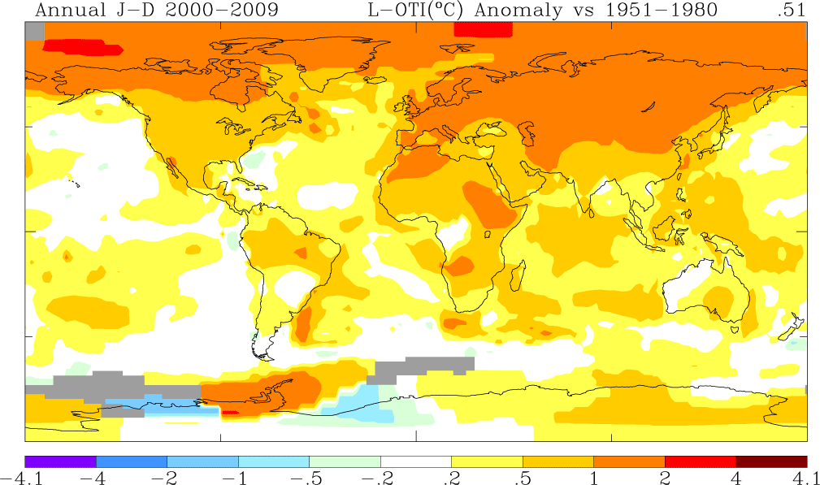
Learning by doing
“Education means making creators.”
- Jean Piaget
Hacking UN’s IPCC’s Climate report
Young students from Semantic*Climate
Shweata N. Hegde
3rd year Undergrad (Life Science and Education)
*Machine understandable

Slide 2

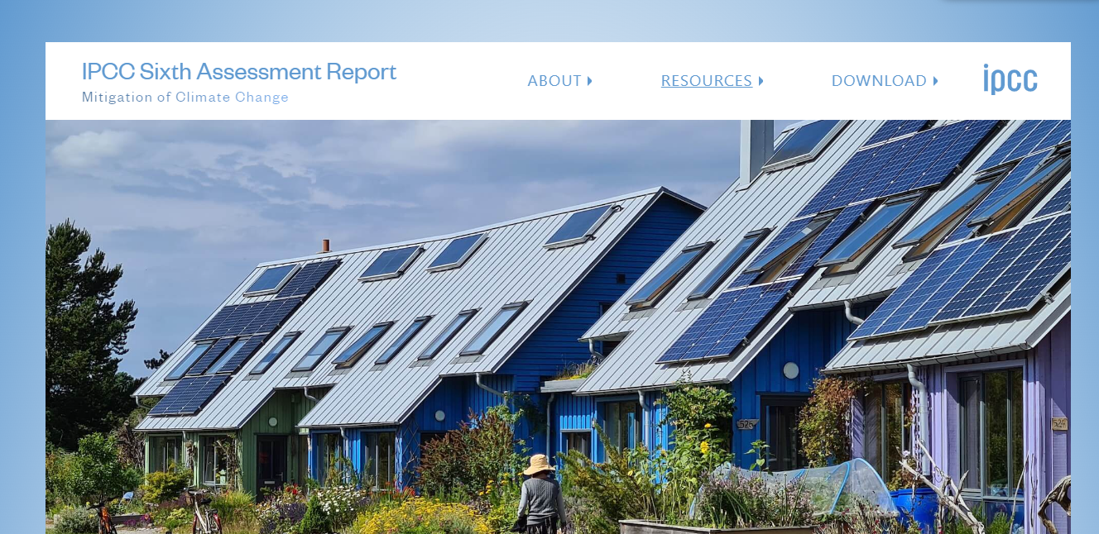

IPCC reports – most important document ever!
3000 pages;
technical
not editable
I can’t read all of that!
But it’s the most important document ever
Computers can help!

Slide 3

Machines can help, but…

Slide 4
Machines can help, but…
They can’t make sense of PDF
Really?
But Semantic Climate Team can help!

Slide 5



SemanticClimate’s tools!
New science and tech!
Climate-related terms dictionary
50 Million Scientific papers
…despite mitigation efforts 8 including those in near-universal nationally determined contributions (NDCs)…
pdfplumber
docanalysis
IPCC chapters
Abbreviation dictionary
Now I can read the reports!
This Photo by Unknown Author is licensed under CC BY-SA
This Photo by Unknown Author is licensed under CC BY-SA
This Photo by Unknown Author is licensed under CC BY

Slide 6
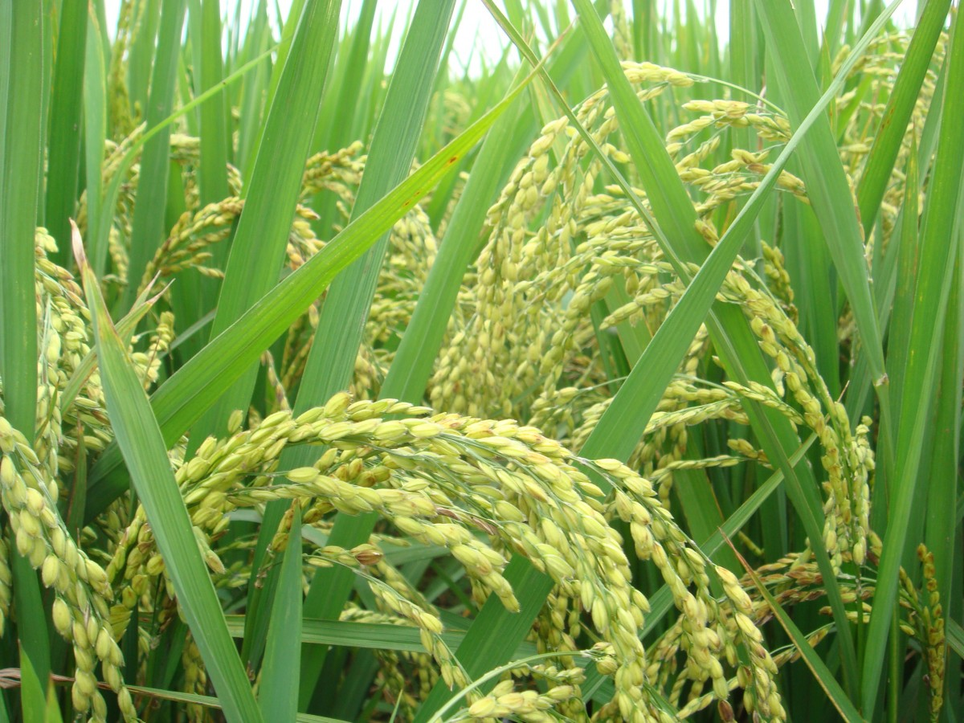


Rolling program of internships with NIPGR
We have learnt…
National Institute of Plant Genomic Research, New Delhi
University students working for 2-6 months in an external organization

Slide 7

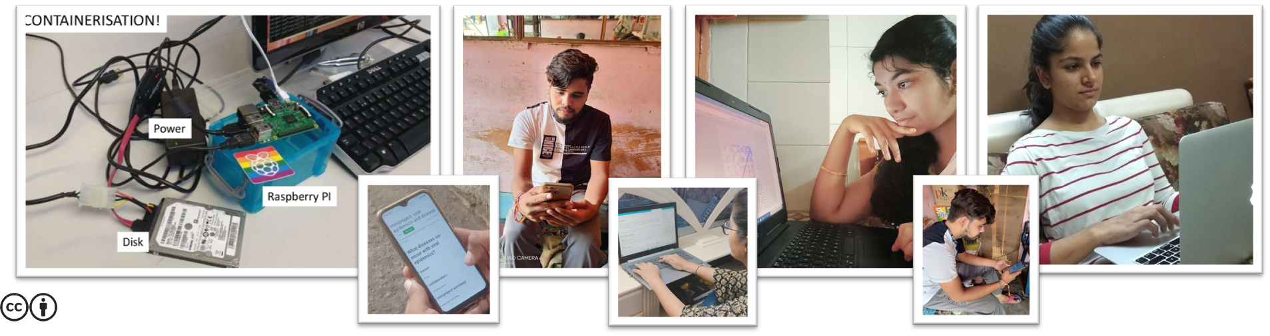
Code! Use tech!
Python
Slide Credit: Ambreen Hamadani
This Photo by Unknown Author is licensed under CC BY-SA
This Photo by Unknown Author is licensed under CC BY-SA

Slide 8

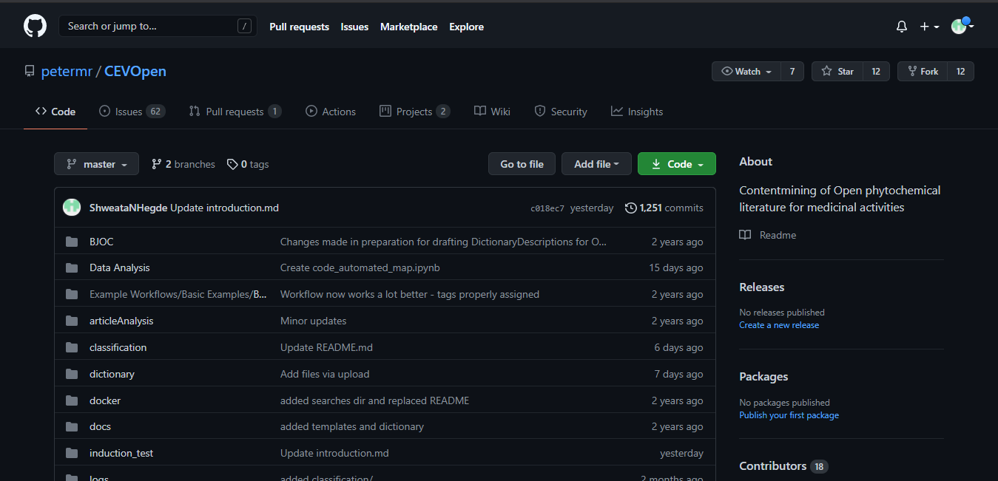

Collaborate…
Updated 19-hours ago
real-time updates!
GitHub
Open Notebook Philosophy*
Try it!
https://github.com/petermr/CEVOpen
https://github.com/petermr/pygetpapers
https://github.com/petermr/pyami
Everything on the web!
*https://en.wikipedia.org/wiki/Open-notebook_science
This Photo by Unknown Author is licensed under CC BY

Slide 9
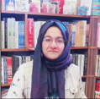
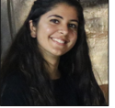
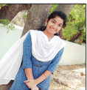
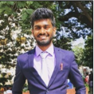
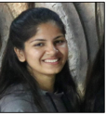
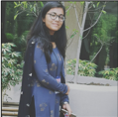
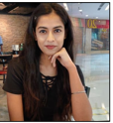
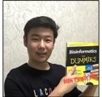

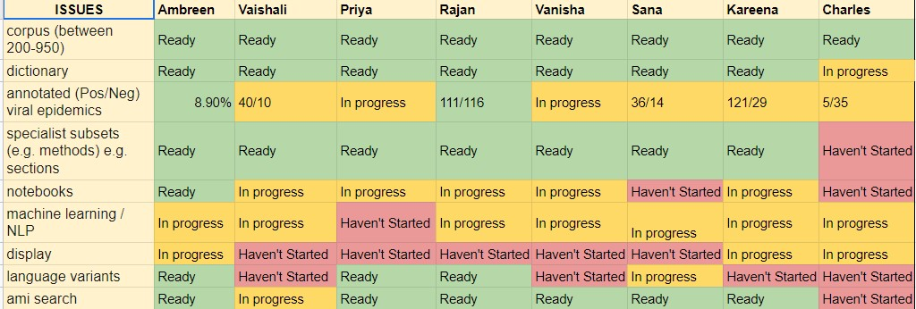
Work as a community and be accountable
People
Not-started
What I Did?
What I Plan to Do?
Blocks?
In-progress
Tasks
Completed
Daily Catch-up
This Photo by Unknown Author is licensed under CC BY-ND

Slide 10
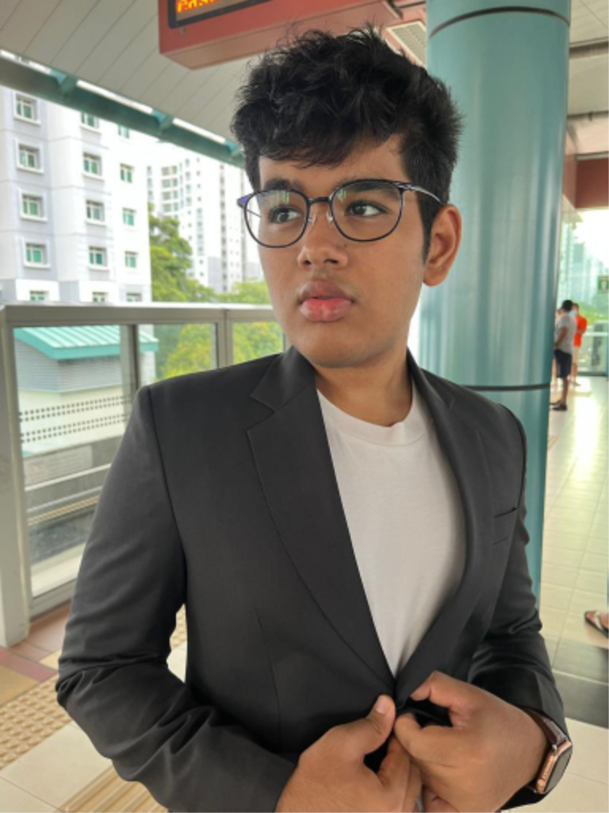
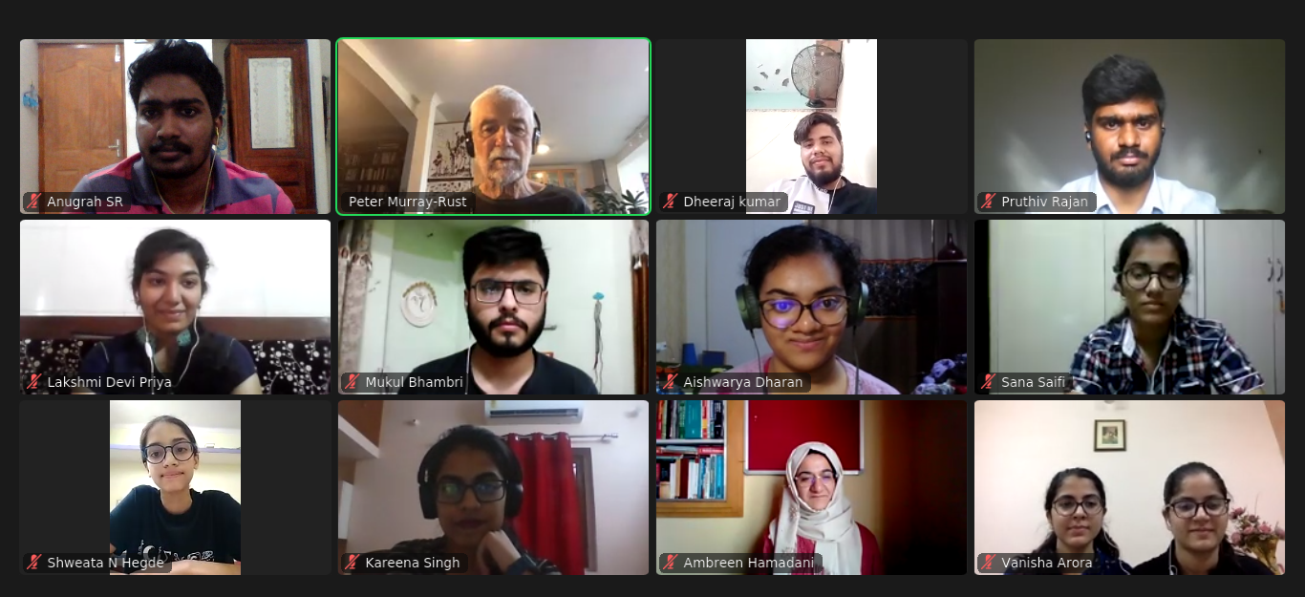
Reach out to the world with our tech
We met Ayush, high schooler – author of pygetpapers -- at a Hackathon!
cambiohack
Maybe we’ll meet our next Ayush today?
Notes:
Traffic Lights -> Spreadsheet + literal traffic light
Daily Stand-ups
What I did
What next
Blockers
Community
Icons > Textual information

Slide 11
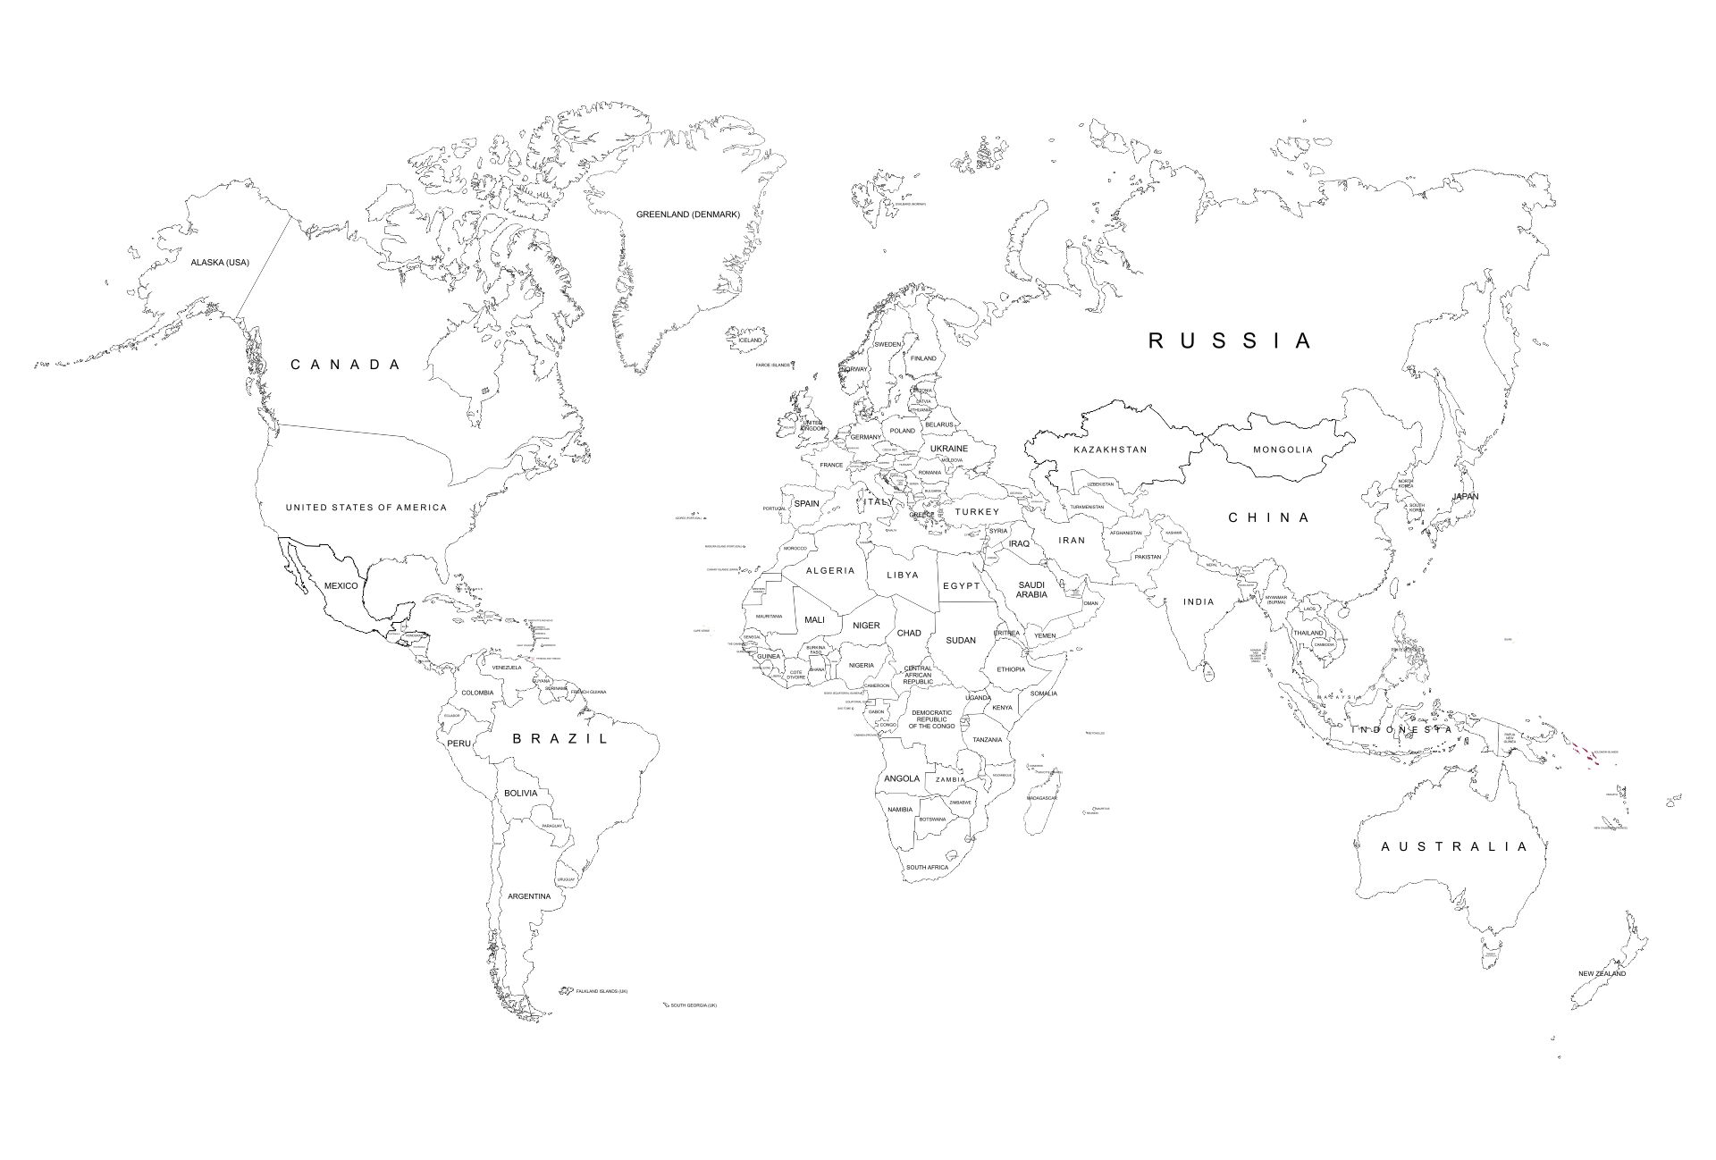
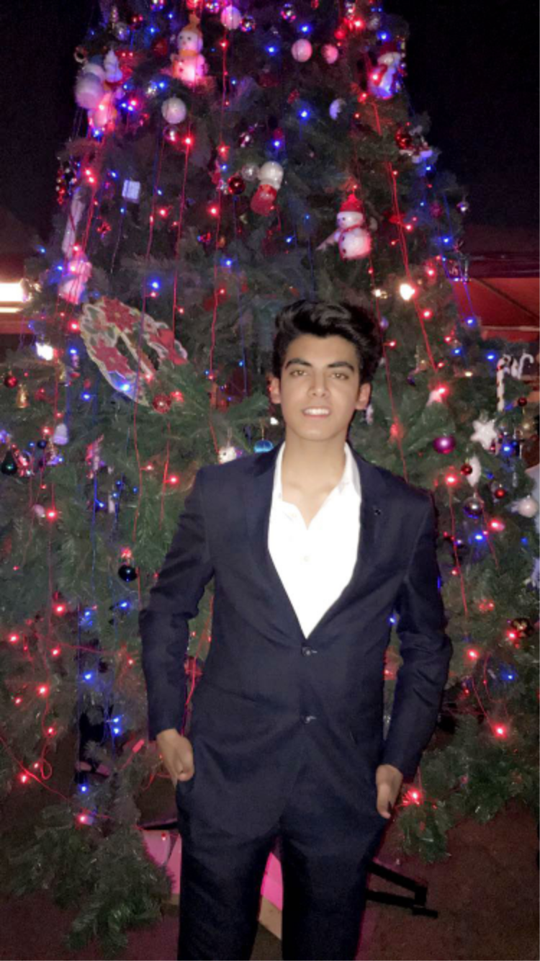
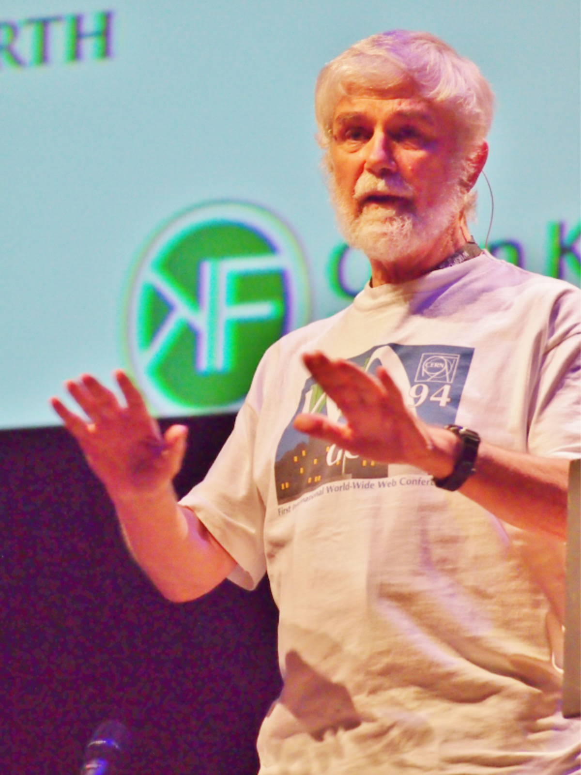

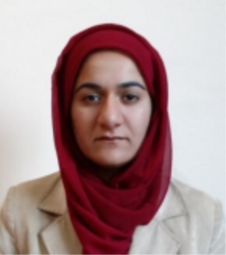
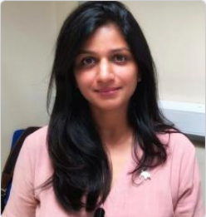
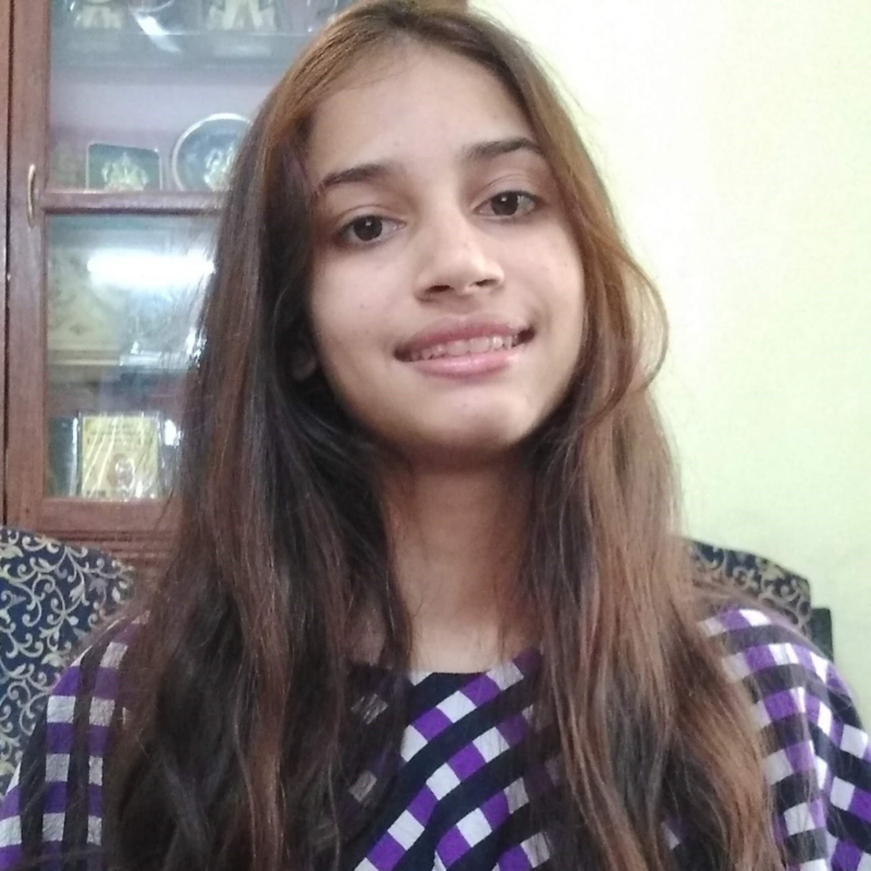
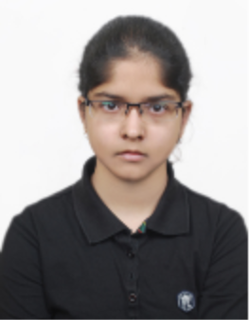
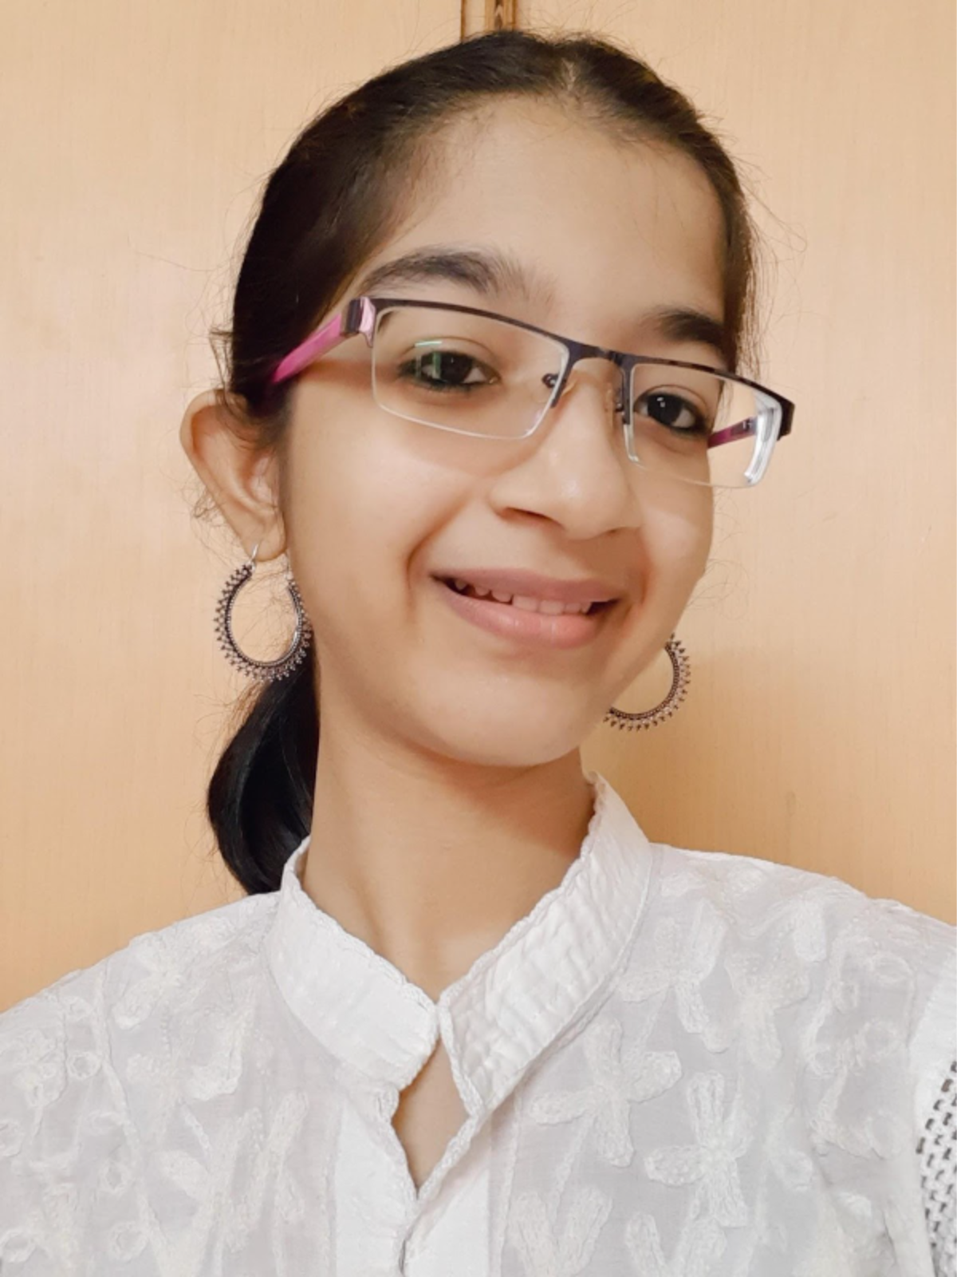
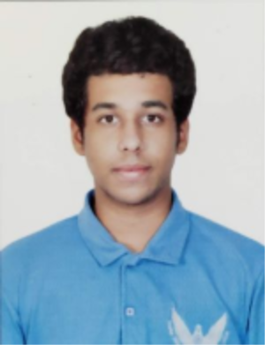
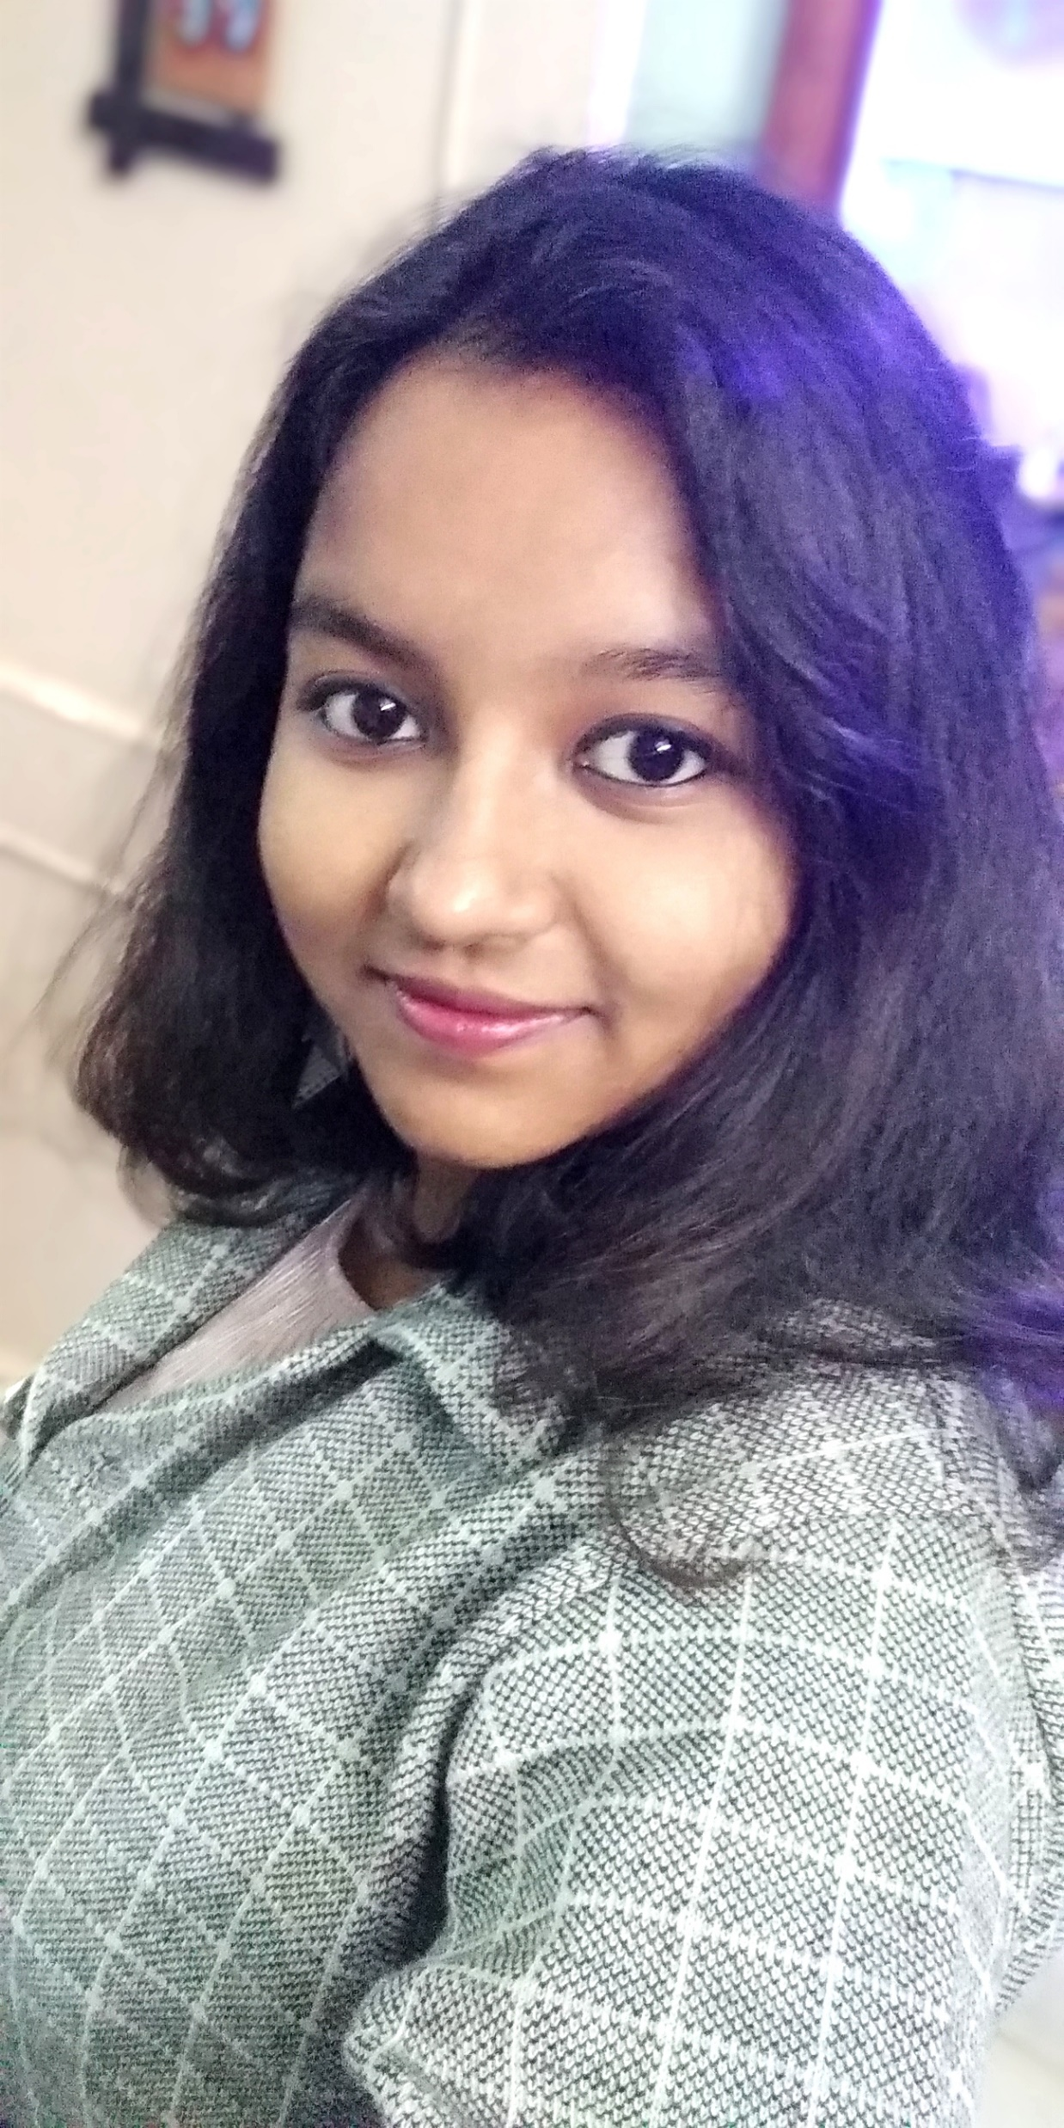
Join the diverse team!

Slide 12
What you might do…
<entry term="cone“ wikidataURL="http://www.wikidata.org/entity/Q22710" wikidataID="Q22710" wikipediaPage="https://en.wikipedia.org/wiki/Conifer_cone">
<synonym>Cone, Conifer cones, Strobilus, pine cone, pine-cone, pinecone, pine cones</synonym>
<synonym xml:lang="zh">松球</synonym>
<synonym xml:lang="de">Koniferenzapfen</synonym>
<synonym xml:lang="hi">कोणधारी कोण</synonym>
<synonym xml:lang="es">cono</synonym>
<synonym xml:lang="fr">cône</synonym>
<description xml:lang="fr">organe reproducteur des conifères</description>
<description xml:lang="es">estructura vegetal</description>
</entry>
Pick a chapter from IPCC report and extract information using our tools!
Select key words and search the scientific literature (EPMC)
Build dictionaries using Wikidata

Slide 13

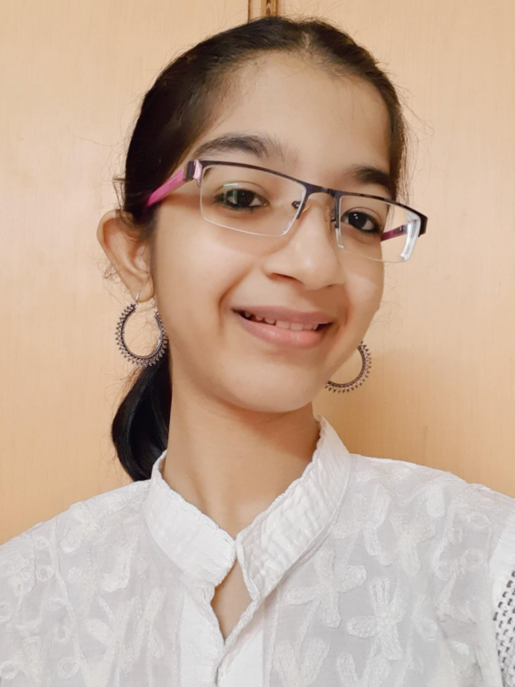

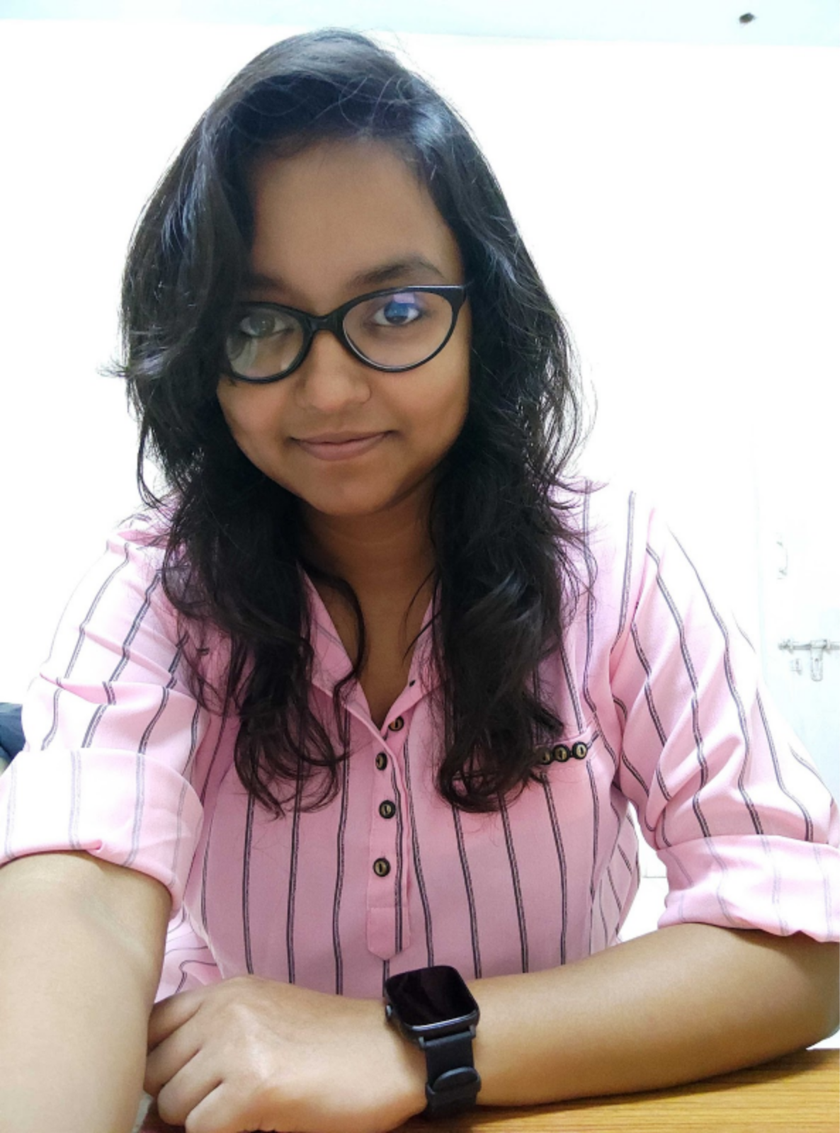
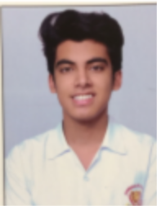

Our Team
Dr. Peter Murray-Rust
Reader Emeritus in Molecular Informatics
Univ. of Cambridge
Dr. Gitanjali Yadav
Group Leader, Computational Biology Laboratory
National Institute of Plant Genome Research
V.S.M.Roopa
BSc. Math,Stats,CS
St. Francis College,
Osmania Univ.
Enakshi Das
MSc. Bioinformatics
Pondicherry Univ.
Kaartik Issar
BSc. Computer Science
Univ. of Toronto
Samarth Bharadwaj
Electrical and Computer Engineering
Northeastern Univ.
Slide Credit: V. S. M. Roopa

Slide 14
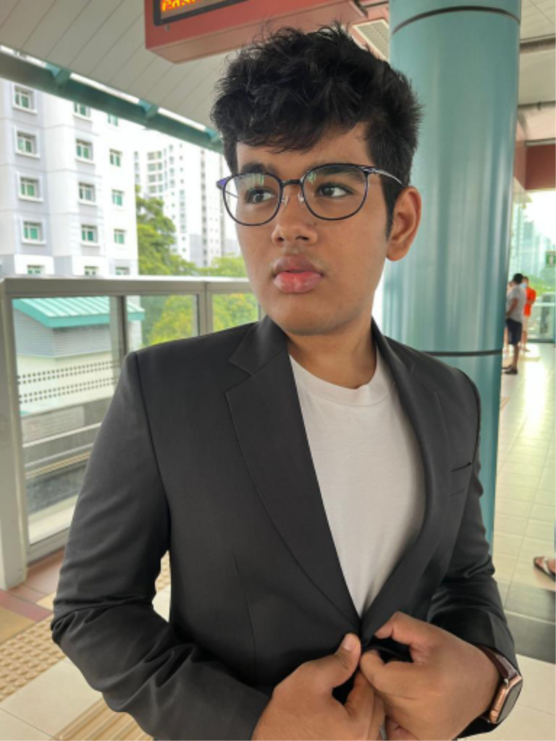



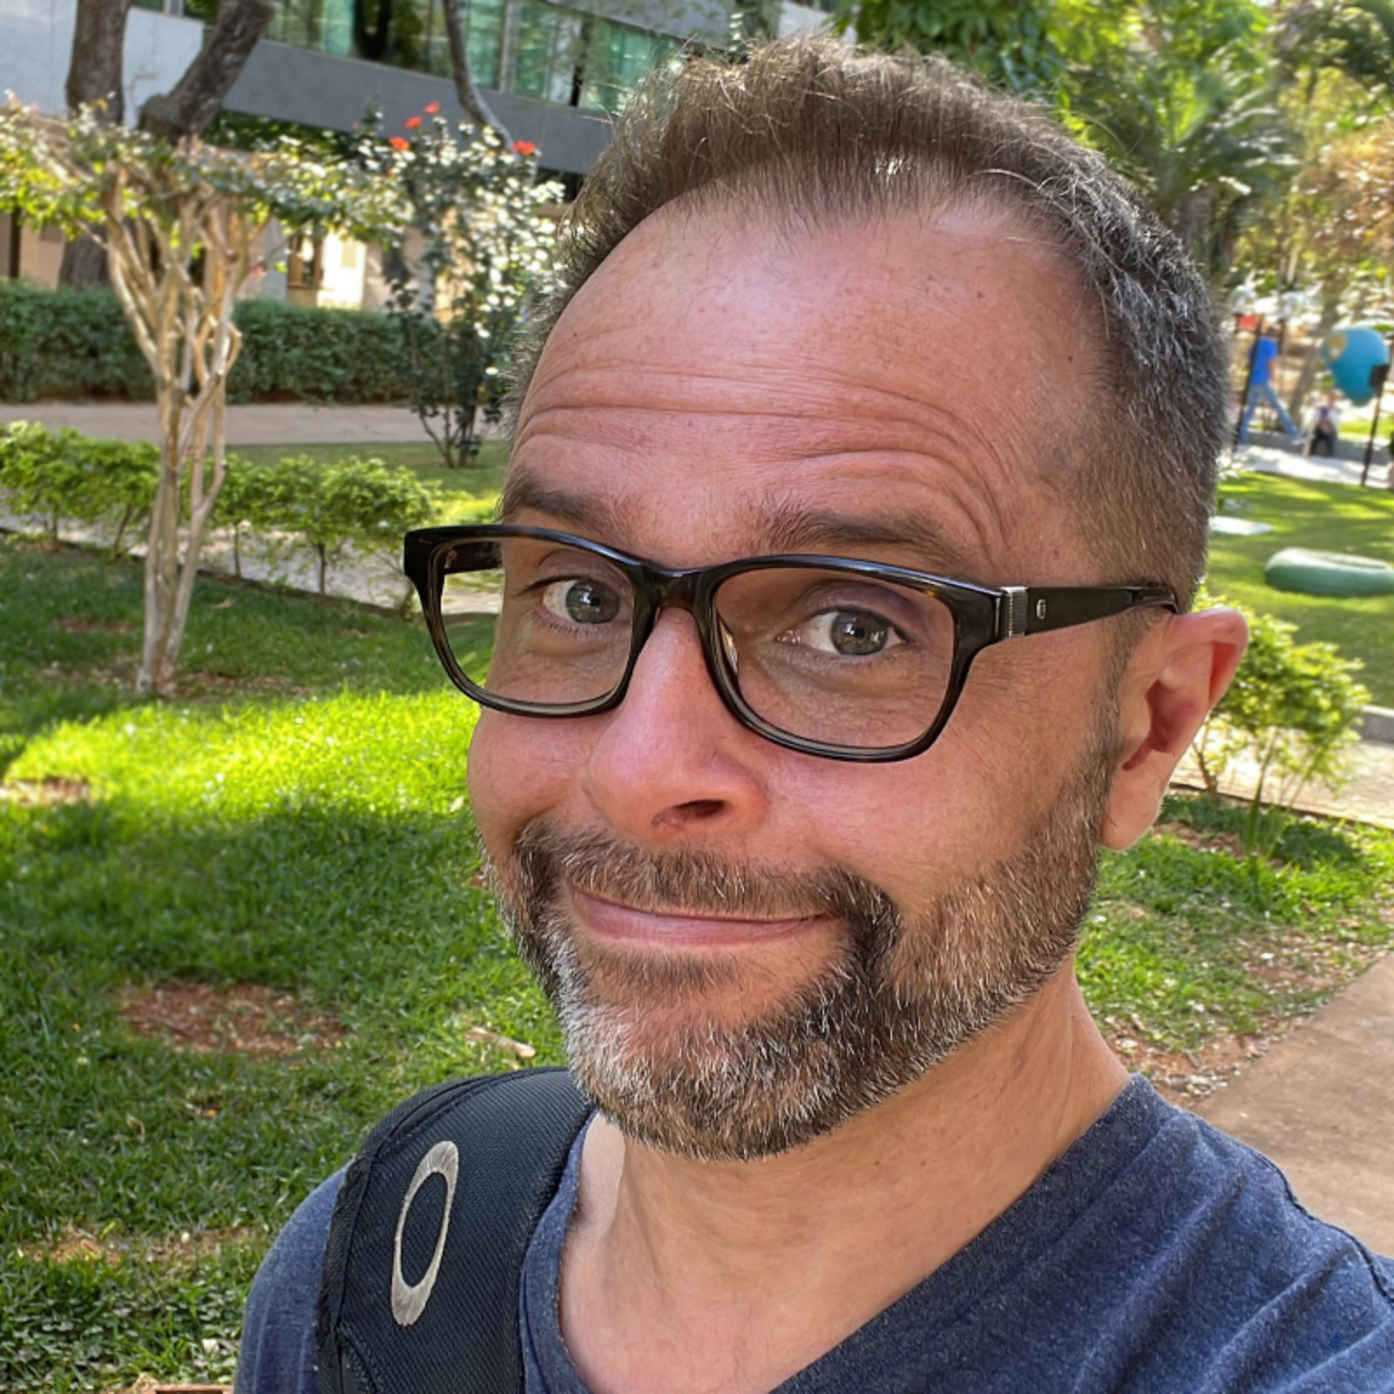
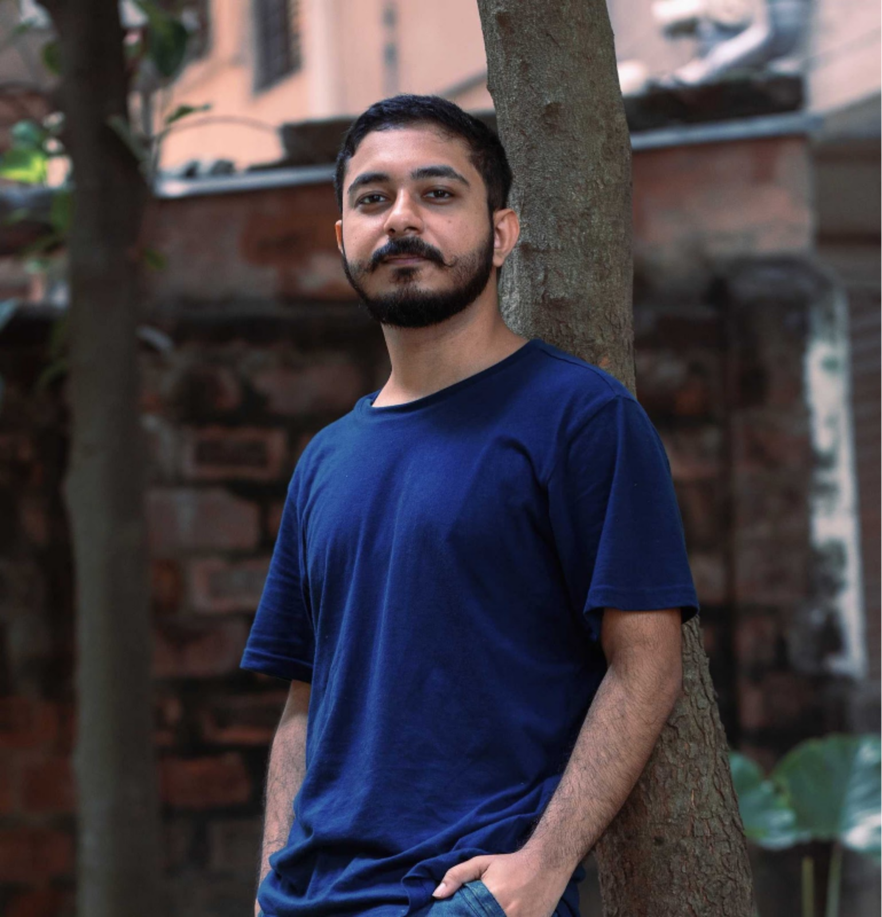
Ayush Garg
BS Computer Science
Univ. of Richmond
Dr Ambreen Hamadani
Lecturer,
SKUAST-Kashmir
Ananya Singha
Electrical Engineering and Computer Science
IISER Bhopal
Shweata N. Hegde
B.Sc. B.Ed.
Regional Institute of Education, Mysore
Emanuel Faria
Plant Medicine R&D,
Verriclear Natural Skin Essentials
Anubhab Chakraborty
Electrical Engineering and Computer Science
IISER Bhopal
Slide Credit: V. S. M. Roopa

Slide 15
Thanks to
More on: https://github.com/petermr/petermr/discussions/37

